Slide 1
History Rewritten
The Electoral College

Slide 2
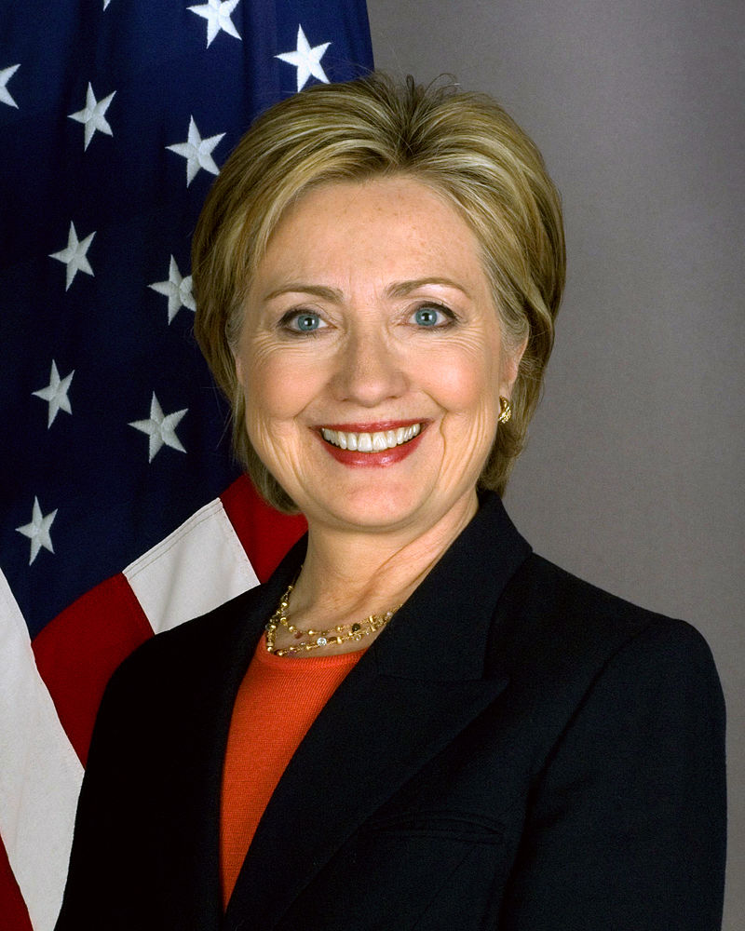
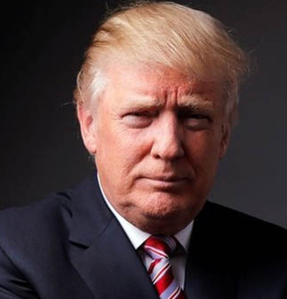
The 2016 Election
Hillary Clinton: 228 Electoral Votes, 60,556,000 votes
Donald Trump: 290 Electoral Votes, 60,116,000 votes.

Slide 3
The 2016 Election
Hillary Clinton only got 1/3rd of one percent more votes
Of the National Population only 57 Percent voted.

Slide 4
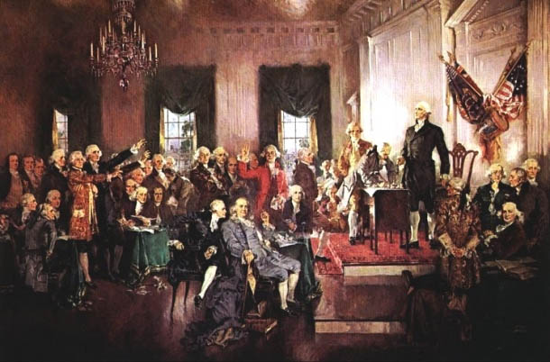
Modern Myth
Sources say the Electoral College has elected four presidents over the popular Vote?
Question, Define “Popular Vote.”

Slide 5
Sources of Stupidity
Fact Check Dot Com Answer: John Quincy Adams (1824), Rutherford Hayes (1878), Benjamin Harris (1888), and George W. Bush (2000).
LA Times, Think Progress, and Others: Rutherford Hayes (1878), Benjamin Harris (1888), George W. Bush and Donald Trump.

Slide 6
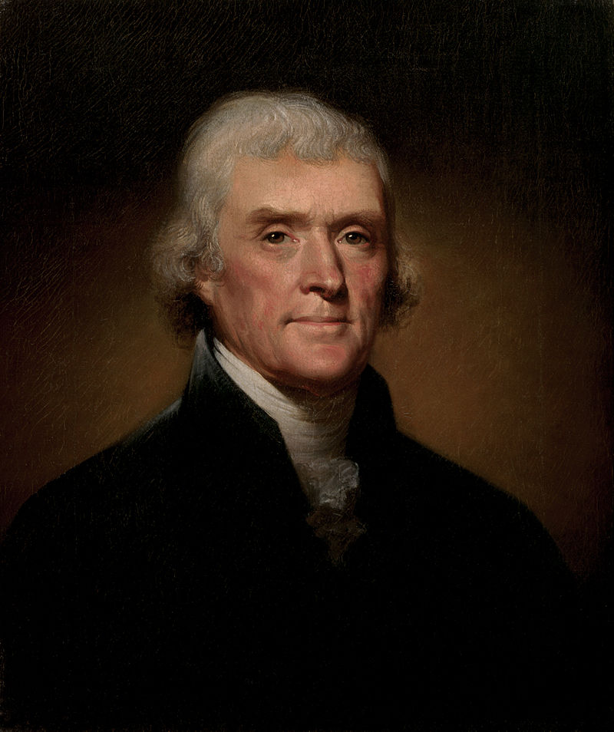
Fact
Thomas Jefferson did not have over 50% of the national Vote when he was elected in 1800.

Slide 7
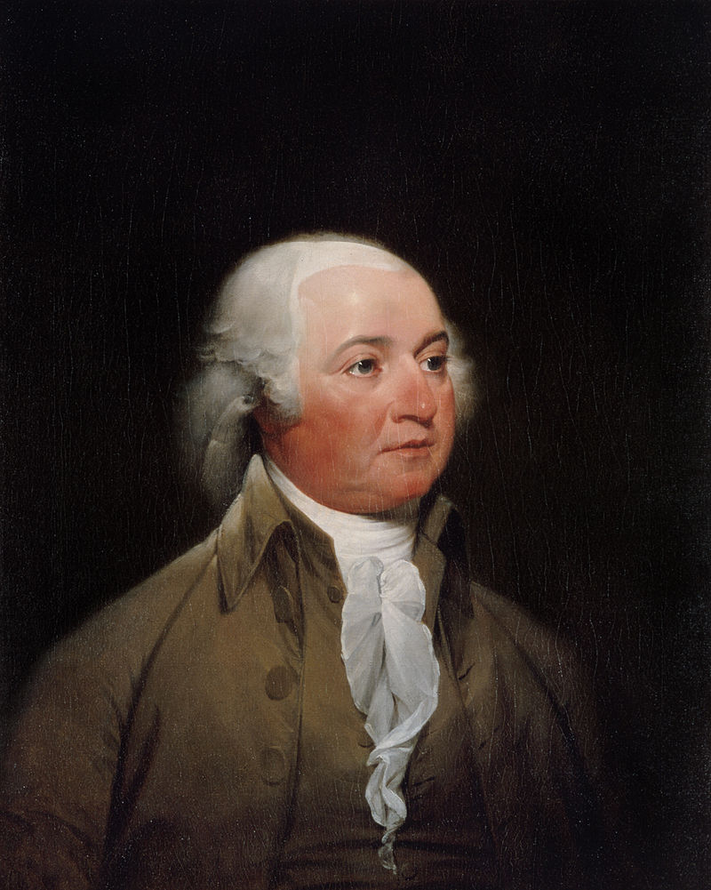
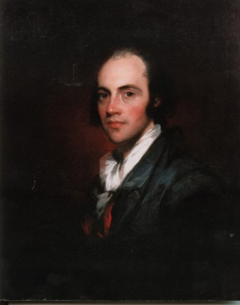
1800
There were four candidates for President, the third being Aaron Burr of New York. This split the vote with Burr actually having the most votes.

Slide 8
Reality
Burr and Jefferson had the same number of Electoral votes- 73
This threw the issue into Congress: Which meant into the hands of Alexander Hamilton.

Slide 9
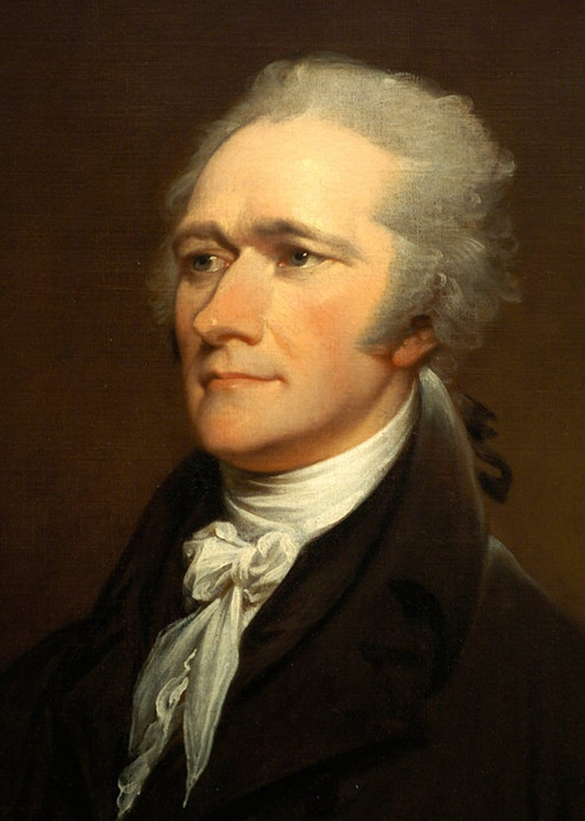
Reality
Hamilton supported a plan where Federalists in the Maryland, Vermont and Delaware delegations abstained their votes, allowing the remaining delegates to vote for Jefferson.
Jefferson now had more votes giving him the Presidency. Burr, by the rules that then existed, became Vice President.

Slide 10
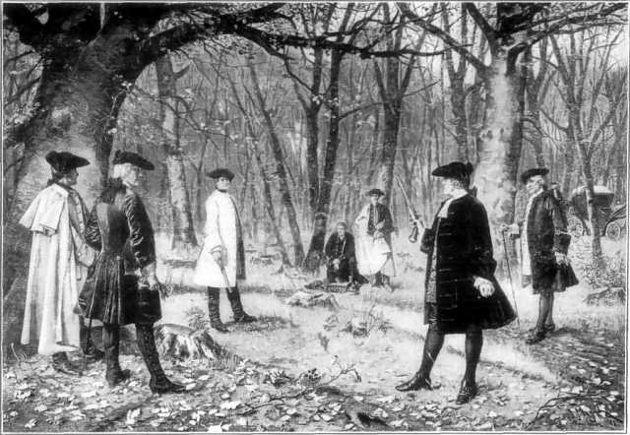
History
In July 1804, Hamilton and Burr met to settle various differences.
Hamilton died and Burr within a year would be under arrest and charged with Treason against the United States.

Slide 11
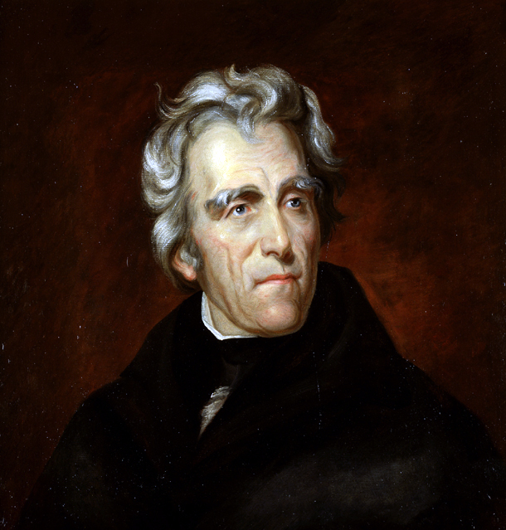
The Next One: 1824
John Quincy Adams VS Andrew Jackson
Again, there were more then two candidates including Henry Clay. All where members of the Democratic Republican party.
Jackson took 41% of the popular Vote to Adams 31%. This gave him 99 electoral votes: But he needed 131

Slide 12
1824
Again it went into the Congress with each State getting one vote.
Henry Clay was no longer a candidate at this point, but still speaker of the House. Thus he threw his support to Adams.

Slide 13
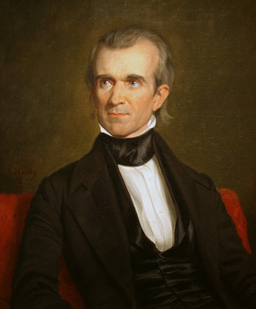
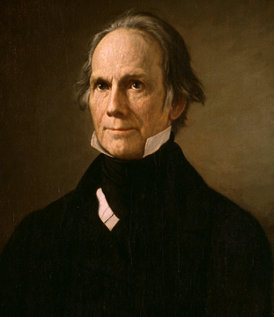
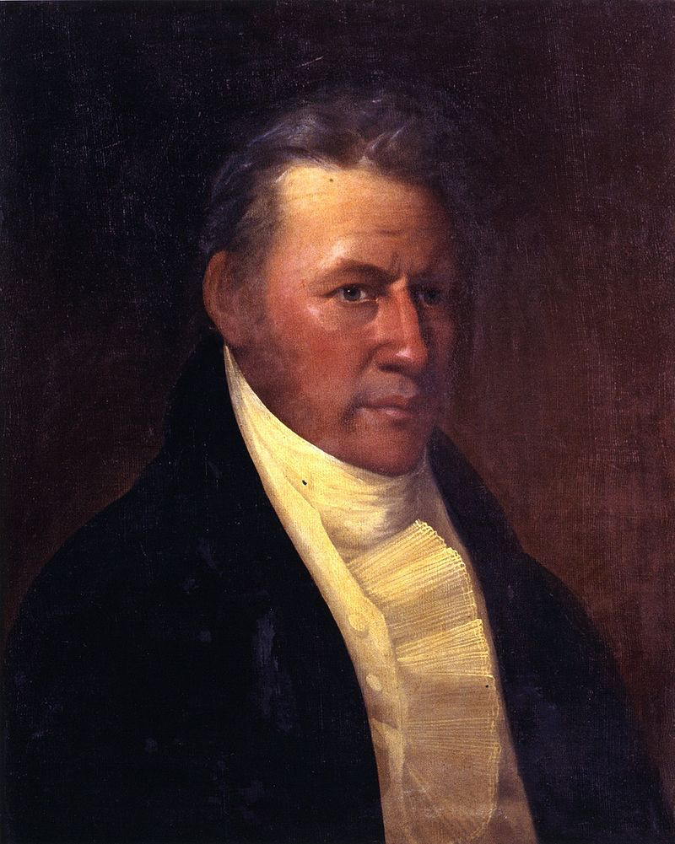
1844
There were three major candidates: James Polk, Henry Clay, and James Birney
Birney took no States in the electoral college, but siphoned off enough votes that the winner, Polk, did not get 51% of the vote.

Slide 14
1844
James Polk (D) got 49.5% to Henry Clay’s (Whig) 48.2%
What put Polk over the top was that he won 170 electoral votes to Clay’s 105.

Slide 15
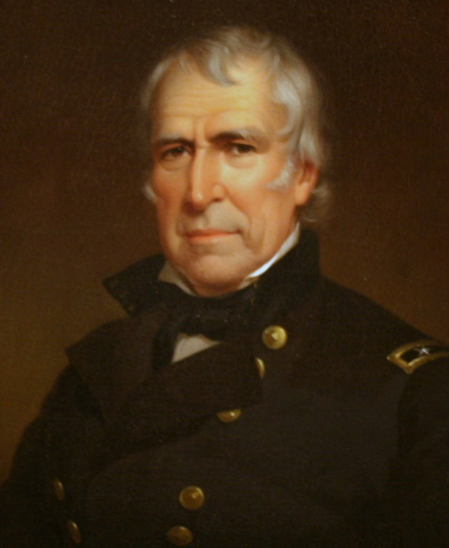
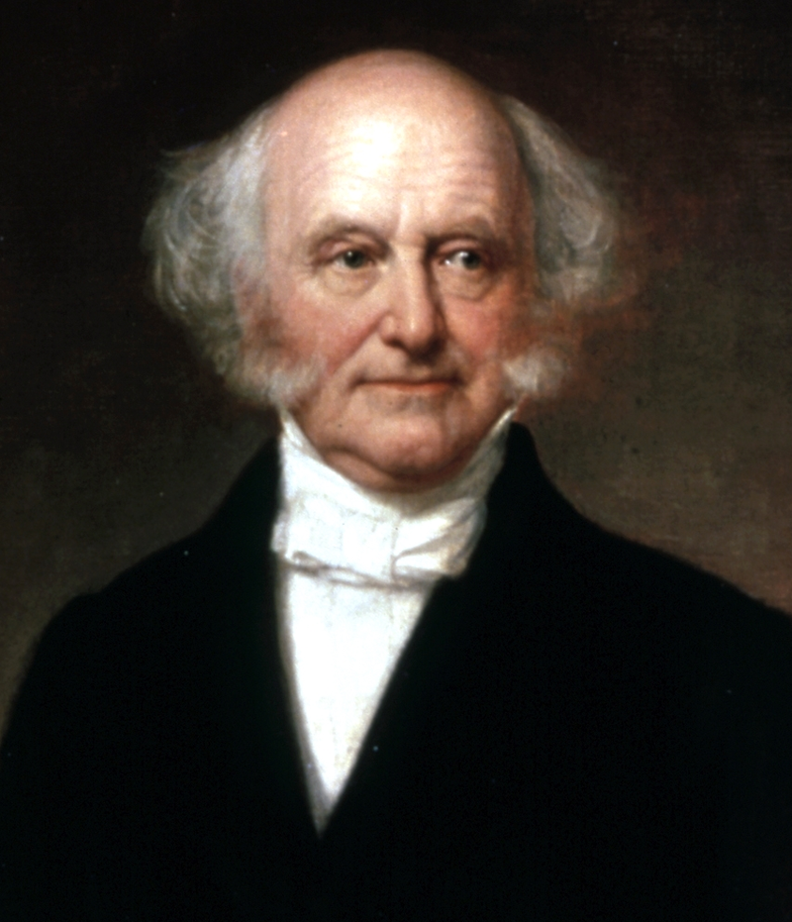
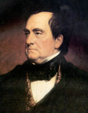
1848
Near identical situation occurred in 1848 when Zackary Taylor (Whig) went against Lewis Cass (D) and Martin Van Buren.
Van Buren took 10% of the vote, leaving Taylor with 47% and Cass with 42.5%.
Taylor took 163 electoral votes to Cass 105, giving Taylor the Presidency.

Slide 16
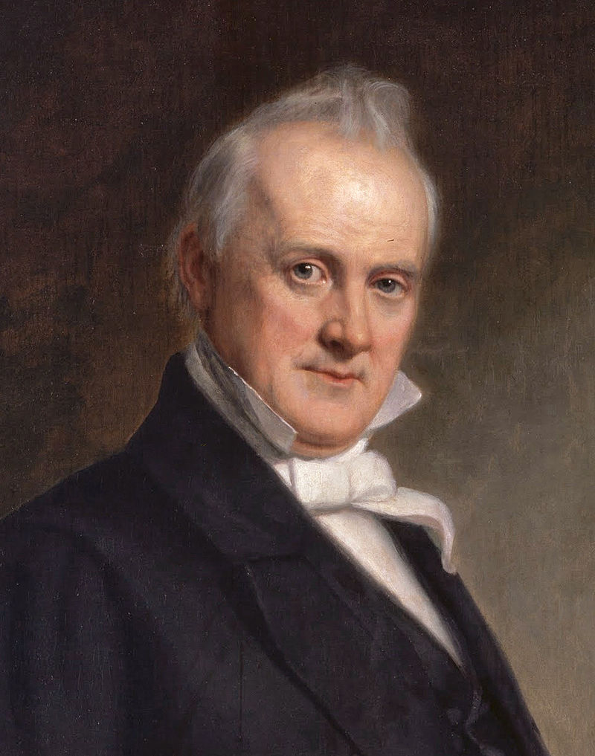
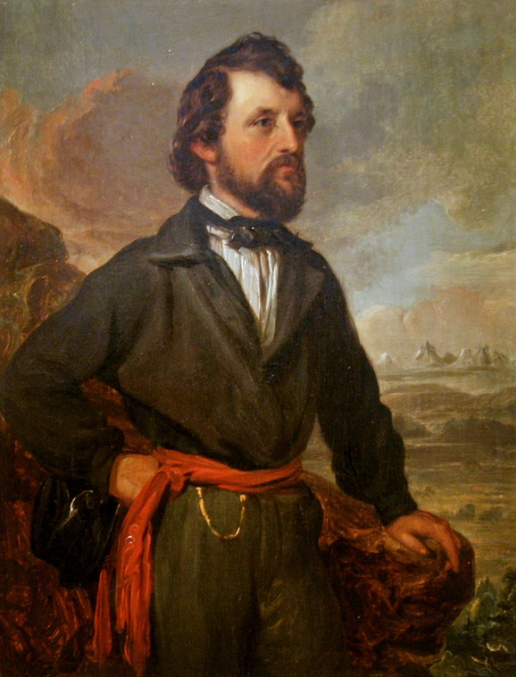
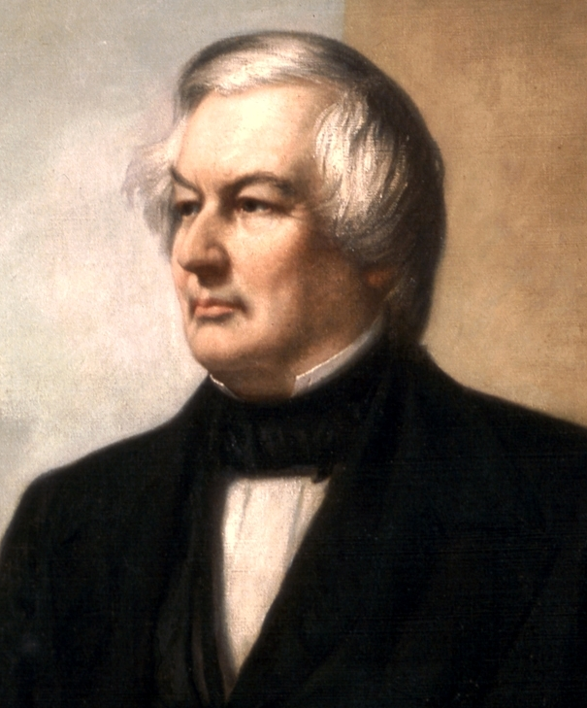
1856
The next one was James Buchanan (D), John Fremont (R) and Millard Fillmore.
Buchanan (D) only had 45% of the popular vote, but had 174 electoral votes.

Slide 17
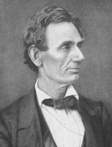
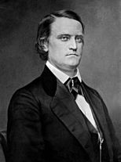
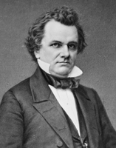
1860
The 1860 election pitted Abraham Lincoln of the new Republican party against a fractured Democratic party.
His main opponents was John Breckinridge (Southern Democrat) and Stephen Douglas (Northern Democrat). John Bell was also running.

Slide 18
1860
Because so many people were running, Lincoln only got 39.8% of the vote. Breckinridge got 18% and Douglas got 29.5%.
Thus a unified Democratic party could have had 47.5% of the vote.

Slide 19
1860
In the end it was the electoral college that decided the election, giving Lincoln 180 votes.

Slide 20
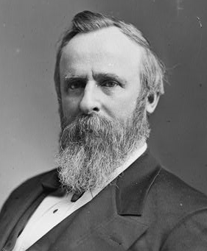
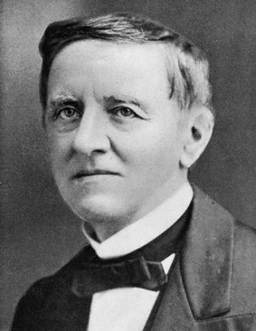
1878
The 1878 election was the next one where Popular vote was overturned. But it was also the most corrupted election ever.
Many States in the South were still under Army occupation after the Civil War and the Democratic party was still associated with Secession.
The KKK had only recently been disbanded and there was continual issues of voter fraud and black voter suppression (both sides).

Slide 21
1878
Regardless of numerous voting irregularities Tilden got 50.9% of the vote to Hayes 47.9%.
The issue was the electoral college where there were 20 Electoral votes that were in dispute.
Tilden had 184 votes but needed 185 to win. Hayes had 165

Slide 22
1878
A special commission was formed by Congress to settle the issue. The situation was so bad one State governor declared 100,000 men were ready to march on Washington,
The commission in a series of 8-7 votes (along party lines) awarded all 20 disputed electors to Hayes. Thus continuing Republican control of the Presidency from Lincoln to Chester Arthur (1881)

Slide 23
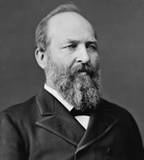
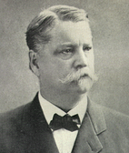
1880
The 1880 election was extremely close.
James Garfield ® had 48.27% of the vote to Winfield Scott Hancock’s (D) 48.25%
Garfield won because he had 214 electoral votes to Hancock’s 155

Slide 24
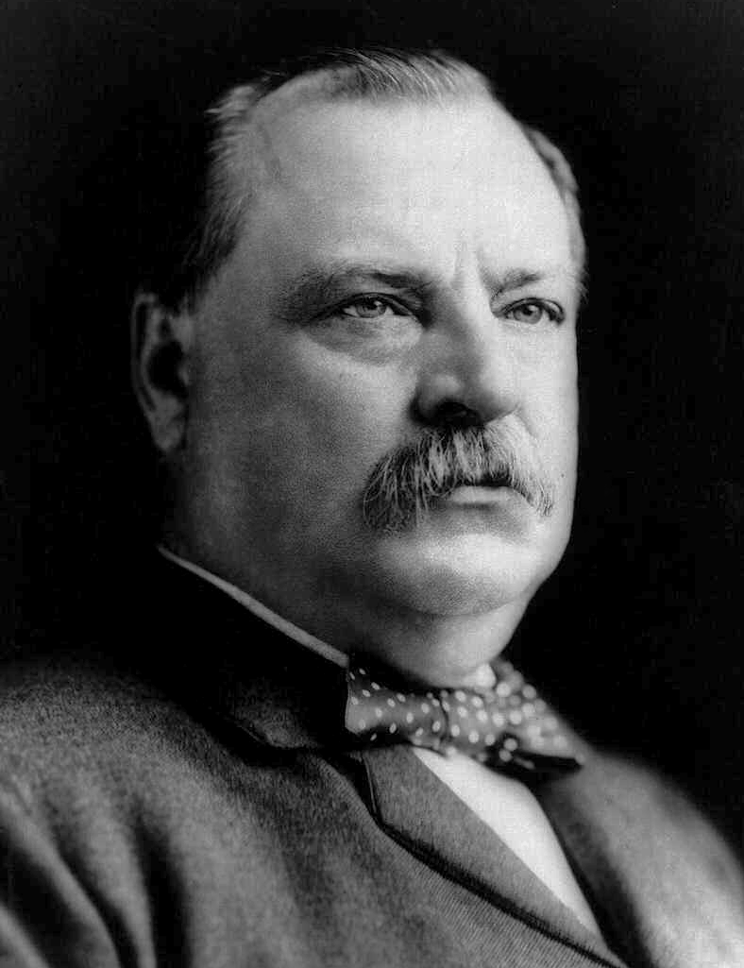
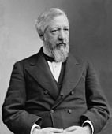
1884
The election of Grover Cleveland (D) over James Blaine ® was also tight with Cleveland getting 48.9% to Blaine’s 48.3%.
Cleveland was the first Democrat to win the presidency since the Civil War. He got 219 electoral votes to Blaine’s 182

Slide 25
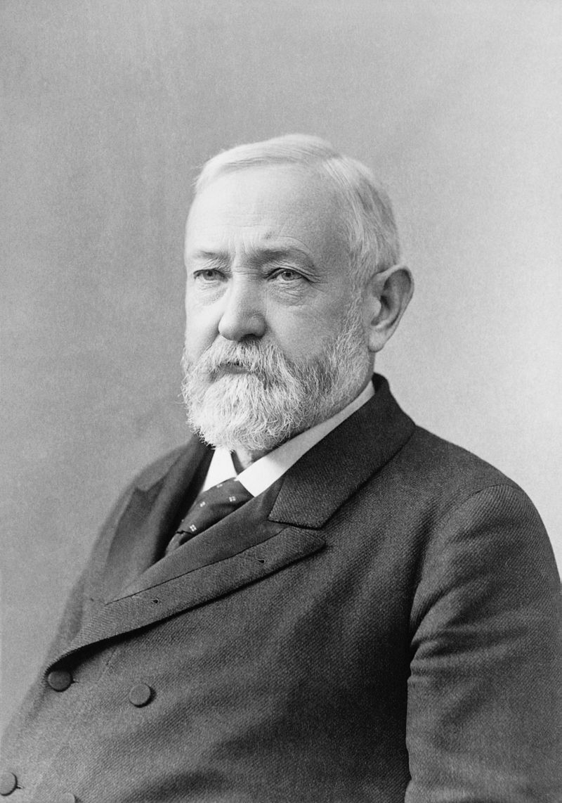
1892
The election between Benjamin Harrison and Grover Cleveland is noted for its vote selling.
Cleveland got 48.6% of the votes to Harrison’s 47.8%.

Slide 26
1888
But Harrison got 233 electoral votes to Cleveland’s 168.
The swing State was New York which was know for vote selling. Harrison won New York even though Cleveland was the home boy.

Slide 27
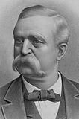
1892
The election of 1892 saw Cleveland again facing Harrison, but with a spoiler in the name of James Weaver.
Weaver took 8.5% of the vote leaving Cleveland with 46% to Harrison’s 43%.
Cleveland won because he took 277 electoral votes to Harrison’s 145.

Slide 28
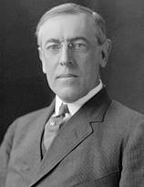
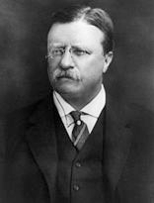
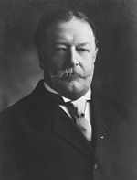
1912
It would take until 1912 for the next election were the winner didn’t get a majority of the votes.
Woodrow Wilson was the outsider: Theodore Roosevelt and William Taft had both been Presidents.

Slide 29
1912
Wilson only got 41.8% of the vote, but with Roosevelt in splitting the Republican ticket he and Taft got only 27.4% and 23.2% of the popular vote.
In the end Wilson (D) got a staggering 435 electoral votes.

Slide 30
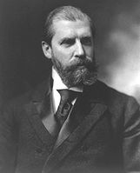
1916
Wilson would then win in 1916 with only 49.2% of the vote to Charles Hughes 46.1%
Wilson got 277 electoral votes to Hughes 254

Slide 31
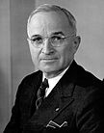
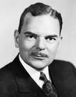
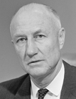
1948
It wouldn’t be until 1948 when a president as elected without having 51% of the vote.
Truman got 49.6% to Dewey’s 45.1%. The spoiler here was Strom Thurmond, Dixiecrat who took 2.4% of the vote, mostly from Truman.

Slide 32
1948
Truman got 303 electoral votes to Dewey’s 189. Thurmond actually got 39 electoral votes.

Slide 33
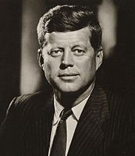
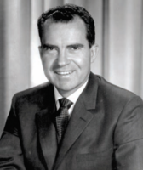
1960
JFK didn’t have 51% of the vote.
Kennedy had 49.7% to Nixon’s 49.5% and a difference of only 110,000 votes
Kennedy however got 303 electors to Nixon’s 219.

Slide 34
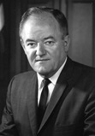
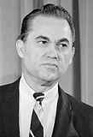
1968
Because George Wallace chose to run as an independent, Nixon only got 43% of the popular vote to Humphrey’s 42.7%.
Nixon received 303 Electors, Humphrey 191 and Wallace 46.

Slide 35
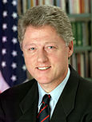
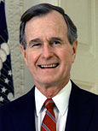
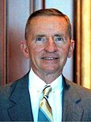
1992
The run by Ross Perot insured the 1992 Election would be decided by the Electoral college.
Clinton received 43% of the popular vote to Bush’s 37.9% and Perot’s 18.9%.
Clinton got 370 electors.

Slide 36
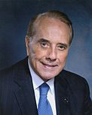
1996
Clinton would have 49% in 1996 when Perot ran again and took 8.4%, most from Bob Dole 40.7%.
Clinton got 379 electors.

Slide 37
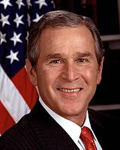
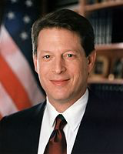
2000
Finally we get to the last example before the present, George Bush and Al Gore.
The spoiler has long been held to be Ralph Nader who won 2.7% of the vote.

Slide 38
2000
Gore received 48.4% to Bush’s 47.9% but Bush received 271 electors to Gore’s 266.

Slide 39
Conclusion
Yes, the Electoral College has five times in 58 presidential elections did not elect the candidate with the popular vote.
It has also allowed for the election of 14 other presidents with out requiring a second national vote to determine who had a true majority.
The ultimate irony is that since 1920 few presidential elections had 55% of the voters vote.

